Slide 1
Trans Action
Building Bridges to Safety
July 27, 2018
AIDS 2018, Amsterdam
Presented by: Amrita Sarkar, Secretary, IRGT

Slide 2
Opening Plenary: Trans People Living with HIV
Moderator:
Erika Castellanos, Director of Programme, GATE
Panellists:
Octavia Y Lewis, Amida Care; Simran Shaikh, India HIV/AIDS Alliance; Jana Villayzan, Red Trans Peru
Summary:
Drawing from personal experiences as long term survivors, panellists shared strategies for survival, advocacy and resistance in the face of many structural and systemic barriers.
Highlights:
Issues affecting HIV/AIDS related services needs to addressed
More resources serving the needs for trans people needs to be secured
Accessing ARV treatment in Government setting is not easy
Feminisation process for trans women is an important need but Government focused HIV programs has only focus on HIV
Majority of trans women are involved into sex work leading themselves vulnerable towards HIV
Access to treatment is the priority irrespective of identity and citizenship
Trans men find difficulties to access HIV related services
Less documentation and research carried out for HIV prevalence among trans men
Trans men are invisible when it comes to access treatment

Slide 3
Barriers to Care and Strategies to Overcome
Moderator:
Musonda Mulopa, IRGT
Panellists:
Manisha Dhakal, Blue Diamond Society, Nepal; Leigh Ann Van Der Merwe, The Socio Economic Determinants of Health for Trans Women in South Africa (SHE); Michelle Ross, CliniQ, UK; Ayden Scheim, University of California, Sam Diego
Summary:
The session had to explore various challenges faced by the trans people in different countries and what are the strategies adopted by trans led organisations to deal with them
Highlights:
Clinical issues concerning trans people’ health needs to be taken care
Nepal - irrespective of legal gender recognition for trans people; still more advocacy is needed to sensitize the health care service providers; Strong advocacy is needed to bring the changes at the policy level
US - sometime health care service providers discourage for HIV test, lack of data about HIV prevalence among trans men, self-testing can be a good option for trans people
Cape Town – a 2011 study shows HIV prevalence was 57% among trans women; a 2016 study shows drinking alcohol at least once a week found among 57% of trans women
HIV testing to be integrated with hormone treatment and other transition related services
Trans people can take part in more research
More advocacy is needed for HIV intervention among trans men

Slide 4
Special Projects of National Significance
Moderator:
Ricky “Rikky” Nathason, TREAT
Panellists:
Joanne G Keatley, Chair, IRGT and Director, Emiretas, UCSF; Jae Savelius and Starley Shade, University of California;
Summary:
Different projects initiated concerning quality HIV care and gender affirmation and healthcare related empowerment.
Highlights:
Study conducted by COE shows among 858 transgender respondents majority of the population are involved into sex work
Disclosed HIV status, health care empowerment, discrimination faced to get shelter, hormone related therapy are the other major concern
Special attention needs to be paid to – younger trans women, Black-African trans women, homeless/unstably housed trans women and trans people involved in sex work
Intervention that were successful at improving retention and viral suppression includes –
Empowering environment and activities
Transwomen in visible staff/mentoring role
Support for self care of staff and
Incentives to attend intervention activities and /or

Slide 5
HIV Continuum for Trans People
Moderator:
Joanne G Keatley, Chair, IRGT and Director, Emiretas, UCSF
Panellists:
Rena Janamnuasook, Thai Red Cross Research Centre; Micah A. Dominigo, Asa Radix, Callen-Lorde Community Health Centre; Tonia Poteat, John Hopkins University
Summary:
Why HIV continuum is necessary for trans people and what are the different strategies adopted.
Highlights:
Thailand – Tangerine Community Health Centre integrated sexual health services with hormone and well-being services; involving social media took a great role and as a result – till May 2018, 92% of the TGW linked to ART and the viral suppression was 90%
NYC - HIV prevelance among trans women is 17.43%, PrEP uptake from January 2012 to June 2018 among the trans and gender non binary people was 55%
Evaluate disparity in PrEP is necessary
To monitor adherence and resistance on PrEP
To improve community awareness on PreP
To provide support to deal with HIV stigma, hormone, insurance and other related issues

Slide 6
Trans Youth at the Table: A Bridge to Our Future
Moderator:
Blessing Bryson, HEAT and IRGT
Panellists:
Dzoe Ahmed, TREAT; Alexander Cortes; Ruksana Kapali, BDS, Nepal and Leah Munoz, Mexico
Summary:
Trans and gender questioning youth are particularly missing in the disclosure. Trans youth leaders from Latin America, Eastern Europe, Asia and Africa shared their perspective on the issues facing by the trans youth.
Highlights:
Latin America – transition process is difficult, Mexico is a transphobic country, ignorance about gender identity/sexual orientation, lack of access to gender recognition and gender identity, lack of trans specific clinic and violence against trans
Africa – low acceptance in society, lack of acceptance leads to sex work making the trans population vulnerable towards HIV and STIs, trans men are not loud
Eastern Europe – people are homophobic and transphobic that leads to violence and harassment, there is no commission hence changing id is a problem, trans people are denied form job that lead to sex work
Nepal – young people have limited knowledge of HIV, health care providers are not sensitive, sustainable way to strategize the movement is needed

Slide 7
Linkages – Trans Programs
Moderator:
Abhina Aher, IRGT and India HIV/AIDS Alliance
Panellists:
Robyn Dayton, Linkages Project, HFI 360; Emily Evens, FHI 360 and Harley Miller, Linkages
Summary:
Linkages presented a review of their trans programs and what are the investment made to support improved programming and reporting. Community led participatory study on gender based violence (GBV) against trans women in Latin America and Caribbean was also shared.
Highlights:
GBV is a known risk factor for HIV transmission and also work as a barrier to HIV services utilisation
Study shows 53% of trans women are involved in sex work, 65% of the same population forced or coerced for sex and 60% of them were forces or coerced for having sex without condom
Consequences of GBV include – emotional distress, physical and/or sexual trauma, restricting movement and behaviours and limited access to services
What linkages is doing –
- Action planning workshop to invest in GBV prevention and response
- Strengthening referral network including IPV service
- GBV training for health care workers and other
- Peer educators raise awareness about the link - between GBV and HIV
- Proactive education about GBV and creating opportunities for disclosure of violence
IEC materials and psychological support
-

Slide 8
Closing Plenary: Empowerment and Resiliency
Moderator:
Mahri Bahti, IRGT
Speaker:
Erika Castellanos, GATE
.
Highlights:
Challenges faced by the trans community
Diversity among the trans community
Identifying common strength as a movement
-

Slide 9
Highlights: Trans Networking Zone
Sessions conducted at the Trans Networking Zone:
From GIPA to MIPA to empowerment of trans women living with HIV in the US
The state of trans and intersex organising 2017 reports
Filling holes, closing gaps and roundtable including transgender MSM in the “MSM and transgender people” HIV response
Discussion on violence faced by the transgender people
PrEP prevention for trans people local needs global awareness
Trans education + action = capacity for health (TEACH)
Using the courts to advance the rights of transgender persons in Southern Africa
Legal gender recognition: How far is South Africa willing to go
HIV prevention tools: Designed for one and applied on all; Does this really work? Here what community experts have to say
Trans and HIV: Who are we really talking about and who is being left behind?
Social support strategies for trans people
Discussion on trans people involved in sex work
Discussion on transmigrants
Discussion on trans Latinas
-

Slide 10
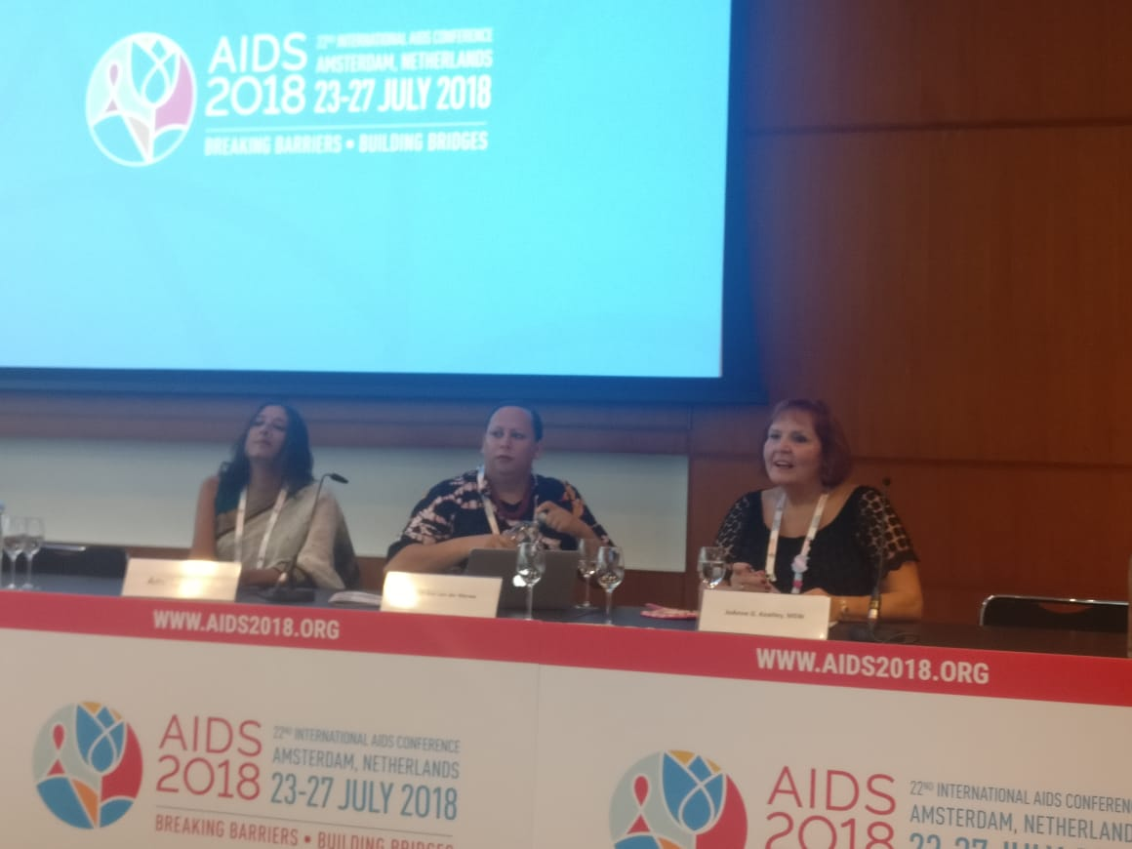
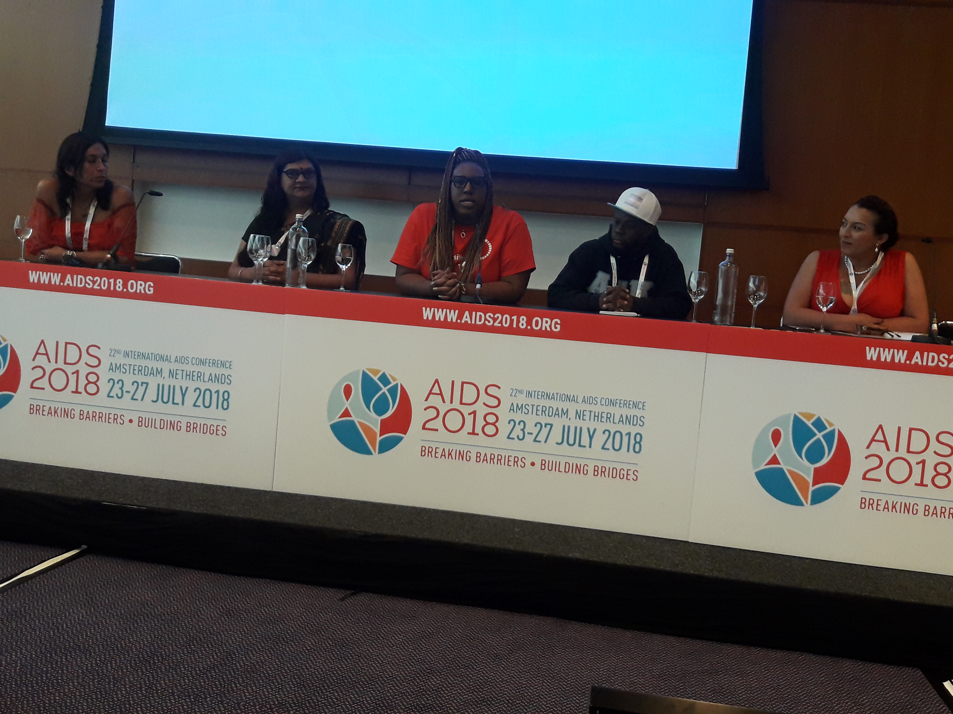
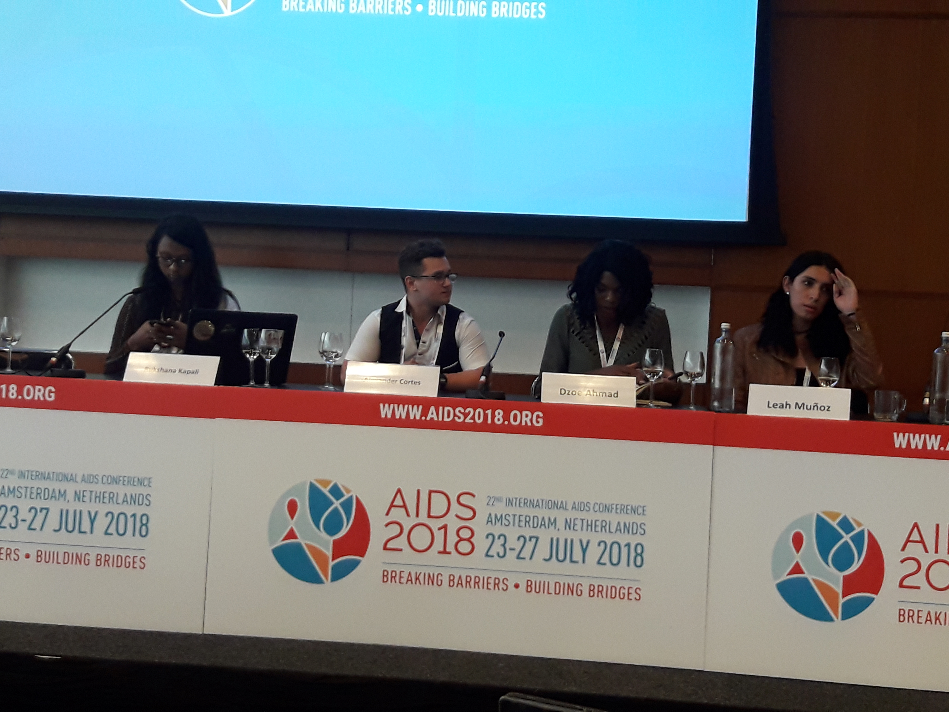
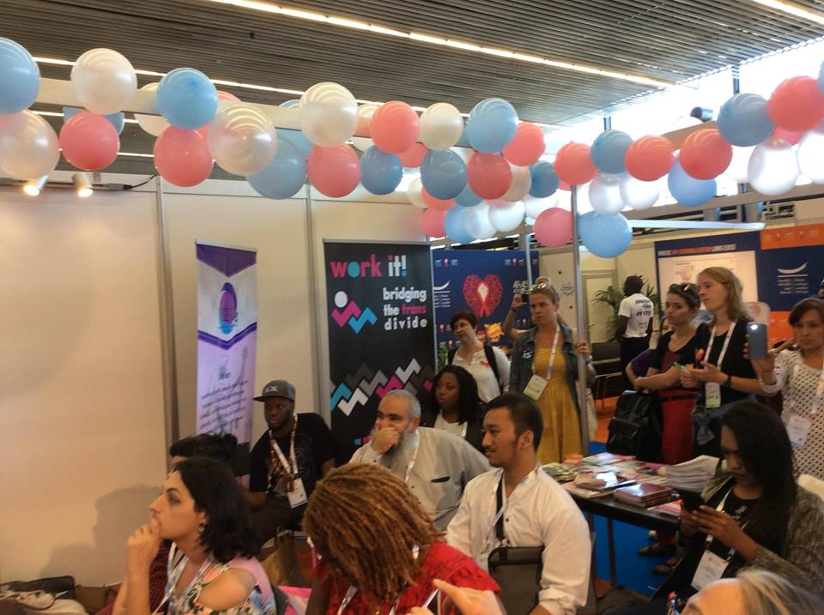
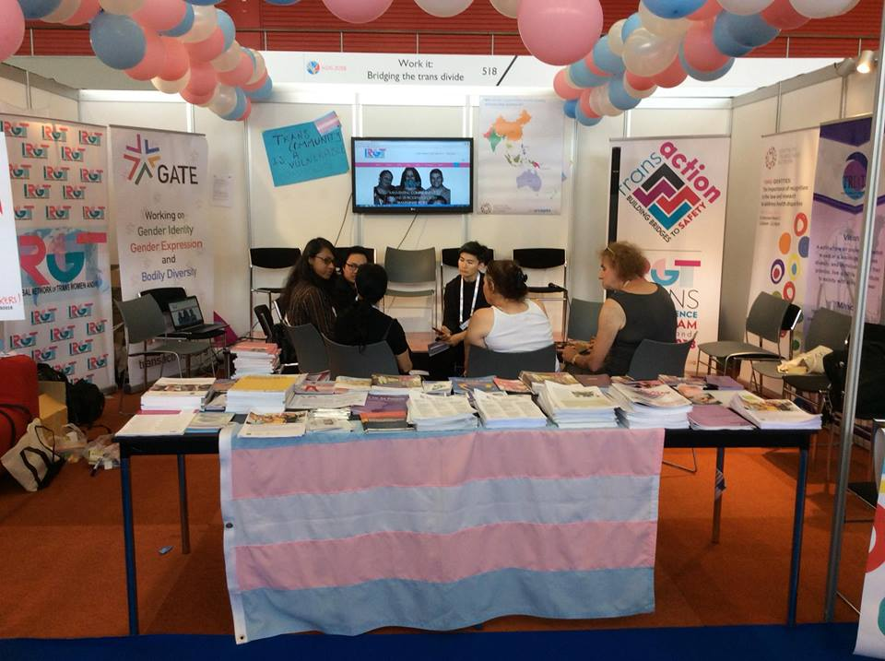
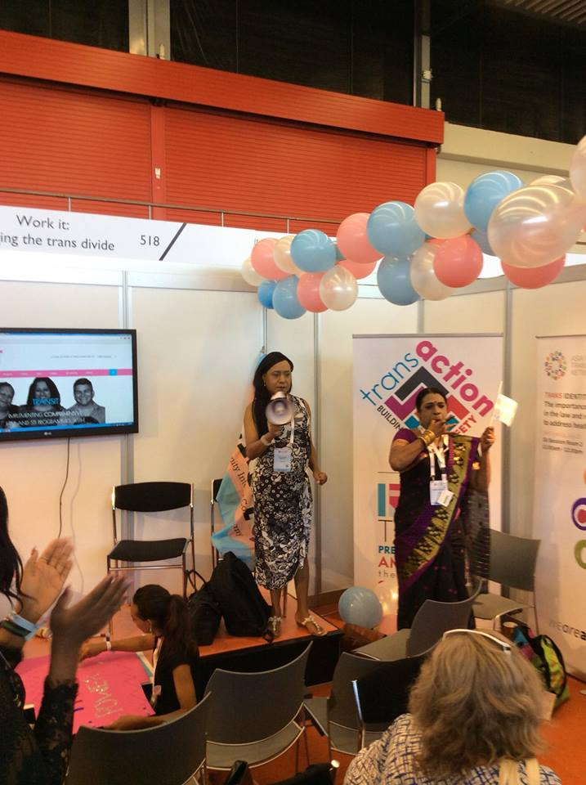
IRGT at AIDS 2018

Slide 11
Acknowledgement
Global Action for Trans Equality (GATE)
Positive Action
Robert Carr Fund
San Francisco Public Health Foundation
UNFPA

Slide 12
Thank You and see you all at AIDS 2020!!
P.O. Box 10073, Oakland, CA 94610

